Slide 1

Viva Connections & SharePoint Framework Bi-weekly sync
aka.ms/m365pnp
Your host in this call: Patrick Rodgers
May 19, 2022
Microsoft 365 PnP Team

Slide 2




Agenda
Latest update on SharePoint Framework
Patterns and Practices Updates
PnPjs
CLI for Microsoft 365
Reusable PnP SPFx controls
New Community Samples
Picture time with Together Mode!
Demos
Anoop Tatti – Building Office Locations Viva Connections Adaptive Card Extension with SPFx
Fabio Franzini - Using Adaptive Cards Designer control from the PnP control gallery in SPFx solutions
Have a great day! 👍
You are awesome! 🧡
Thank you for being part of the community 👏

Slide 3
Opportunities to Participate in PnP SPFx / JS SIG
SPFx Demo
@pnp Demo
Contribute on GitHub
Provide Feedback
Web Part
Application Customizer
Provisioning
Anything you create!
PnPjs
CLI for Microsoft 365
SPFx Reusable Controls
SPFx Community Yeoman
Report Issues
Submit Pull Requests
Help with issues/questions
How are the calls?
Documentation needs?
Where can we help?
Positive is OK too!
Great opportunity to get visibility for you or your company. Demo sample or explain how you extend or customize SharePoint Online with live demo in your projects. Reach out to team for volunteering.
Request a demo spot on the call
https://aka.ms/m365pnp/request/demo

Slide 4
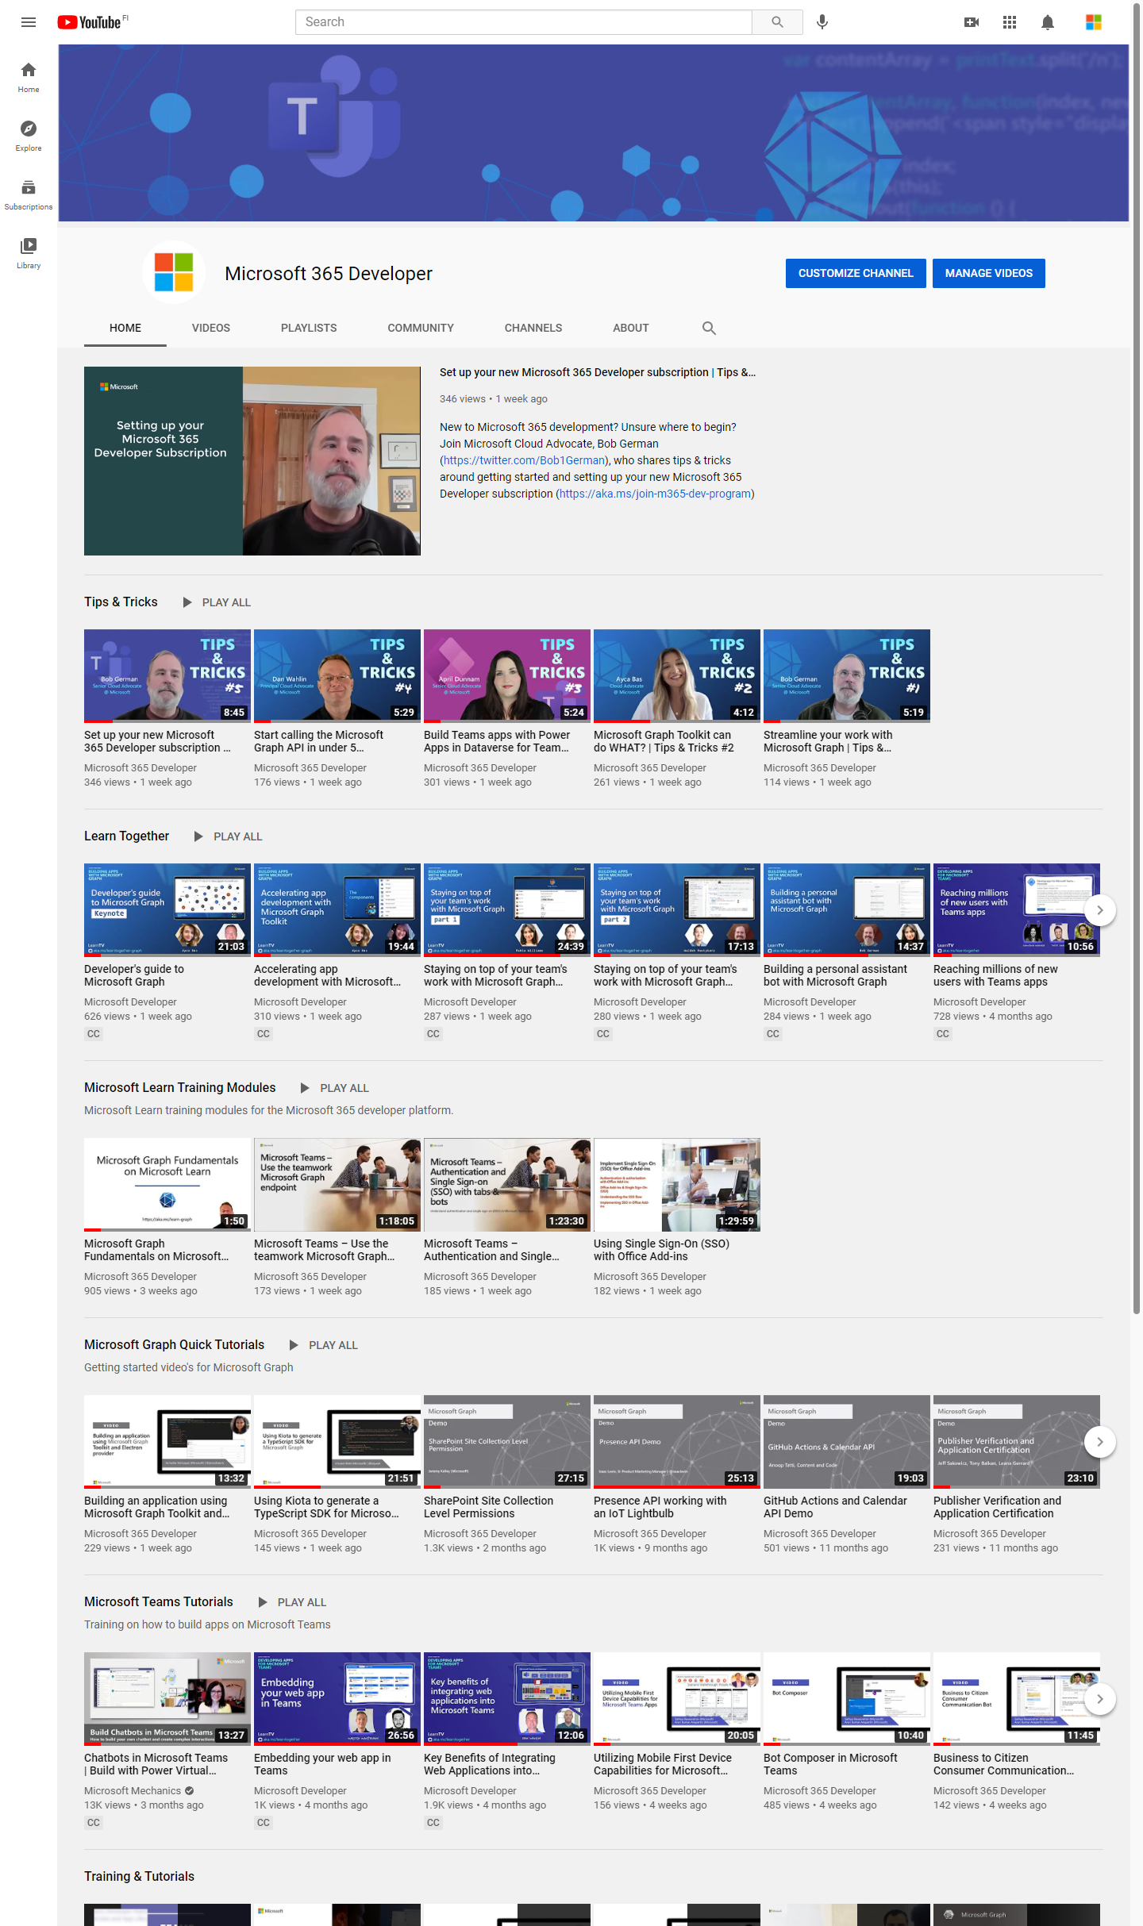
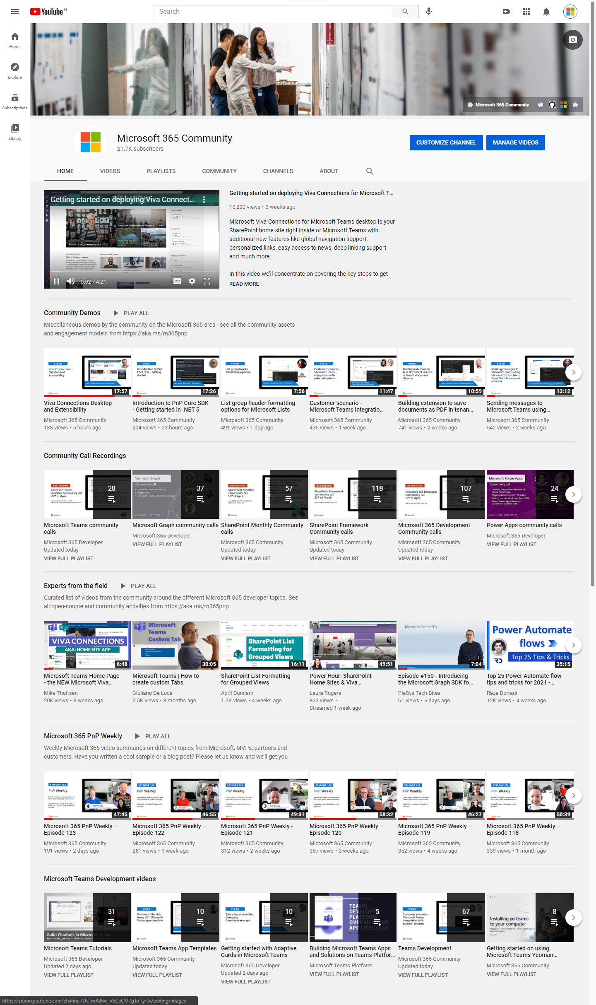
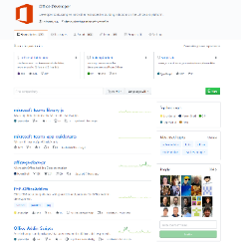
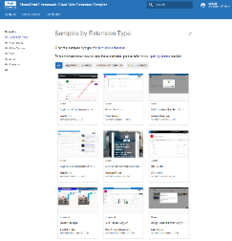
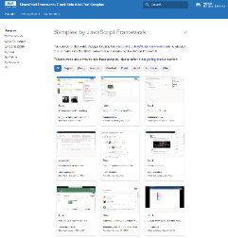
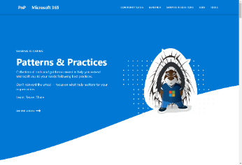
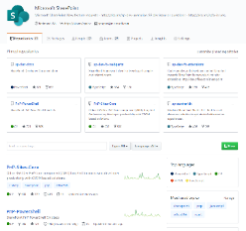
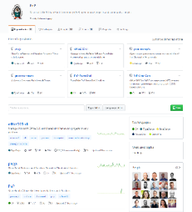
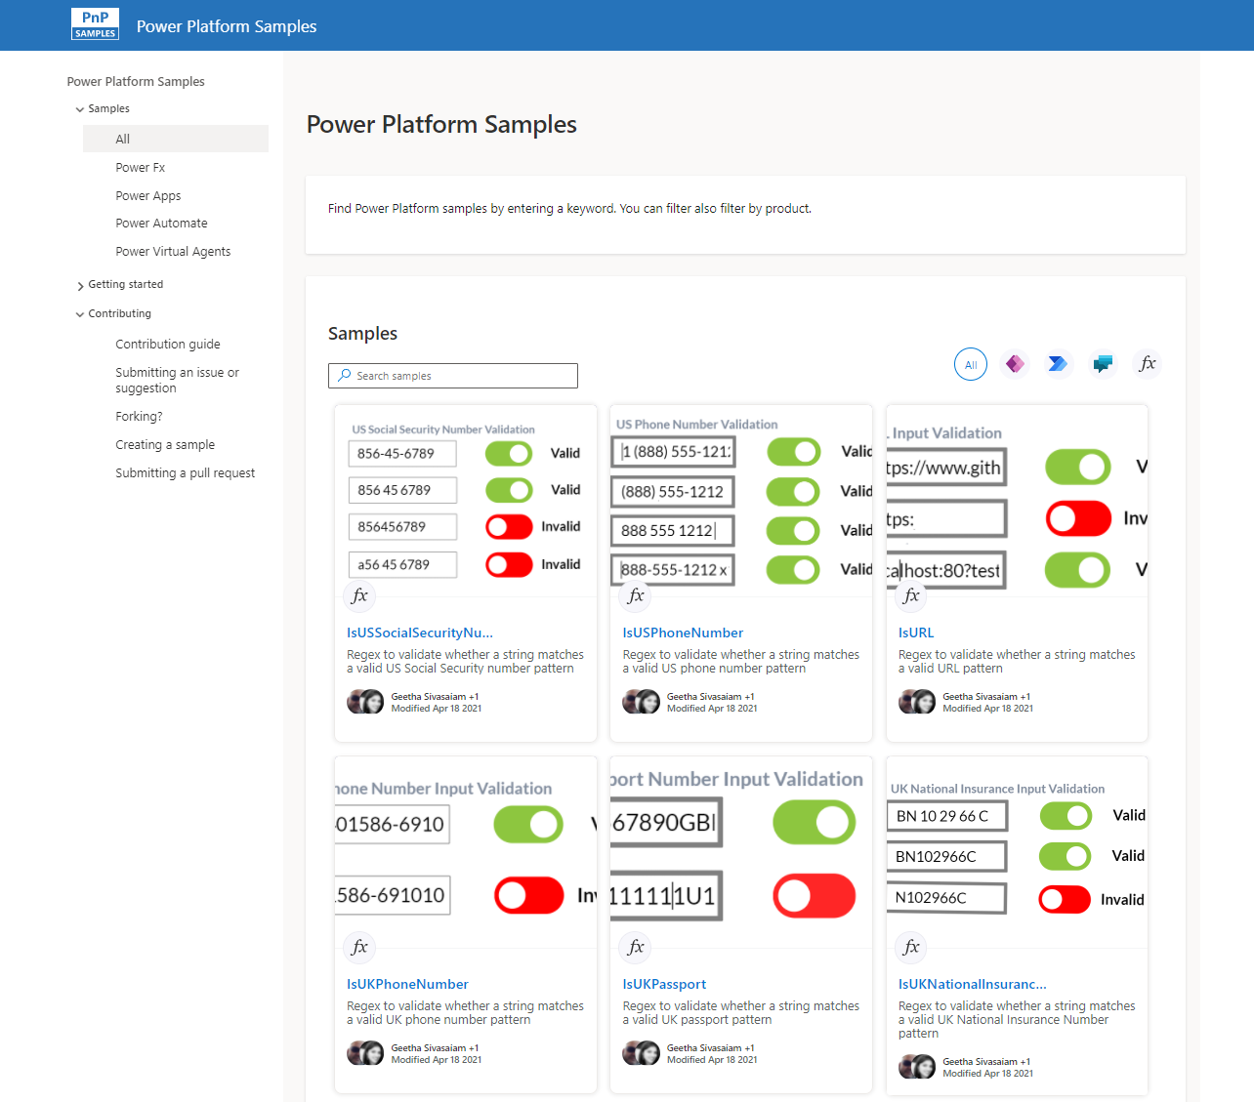
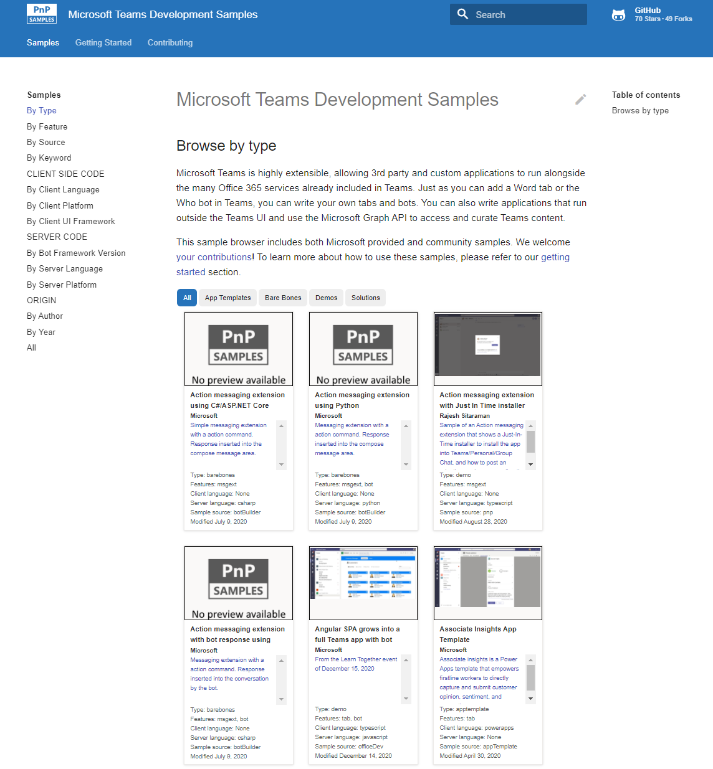
Microsoft 365 developer videos
Microsoft 365 community videos
Open-source
Sample galleries
Open-source initiatives and samples
aka.ms/m365devyoutube
aka.ms/m365/videos
github.com/pnp
github.com/officedev
github.com/microsoftgraph
github.com/sharepoint
aka.ms/m365/samples
aka.ms/teams-samples
aka.ms/spfx-webparts
aka.ms/spfx-aces
aka.ms/powerplatform-samples
aka.ms/spfx-extensions
aka.ms/list-formatting
aka.ms/m365/community
@Microsoft365Dev | @m365pnp
One URL to rule them all…

Slide 5
Microsoft 365 developer community calls
Microsoft 365 platform (weekly) https://aka.ms/m365-dev-call
(Notice. This call is on a summer break between July 1st and 31st of August 2022)
Adaptive Cards https://aka.ms/adaptivecardscommunitycall
Microsoft identity platform https://aka.ms/IDDevCommunityCalendar
Office Add-ins https://aka.ms/officeaddinscommunitycall
Power Platform https://aka.ms/PowerPlatformCommunityCall
Microsoft 365 and Power Platform community (bi-weekly) https://aka.ms/m365-dev-sig
Viva Connections & SharePoint Framework (bi-weekly) https://aka.ms/spfx-call
Download recurrent invites from
https://aka.ms/m365/calls
Notes:
m365-dev-sig

Slide 6
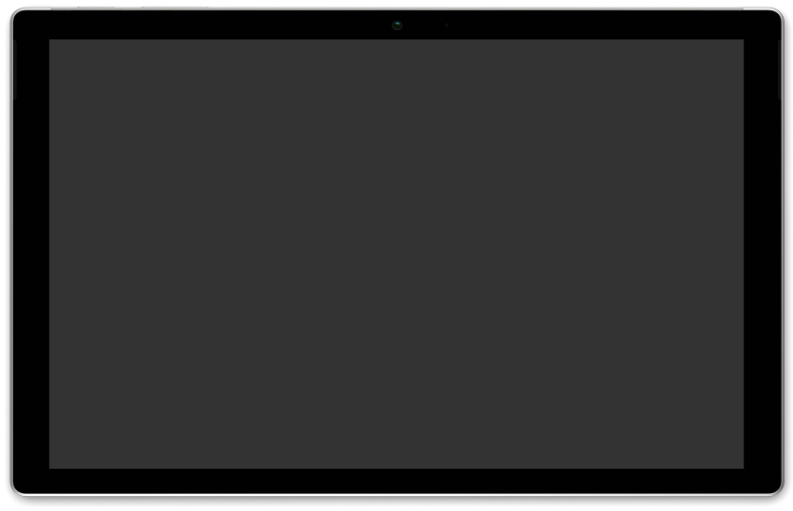






Latest news from Microsoft engineering on Microsoft 365 topics
Monthly community contributors
Community together mode group photo
Corina Strein & Vesa Juvonen- Introduction to Microsoft Viva ISV benefits program
Satya Nadella - Build 2022 Keynote Watch Party – starts half past the hour
AGENDA
Microsoft 365 platform call 24th of May @ 8 AM PT
Weekly call with Microsoft presenters covering the latest Microsoft 365 platform updates
Download recurrent invite from https://aka.ms/m365-dev-call
Notes:
Dan’s slide

Slide 7
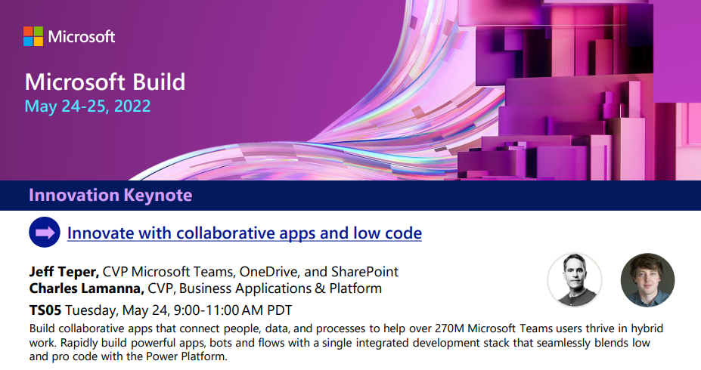

SCHEDULE
Collaborative Apps session introduction now available
Breakout sessions, on demand videos, Ask The Experts, Product Roundtables and more… 🚀
https://aka.ms/m365/build22

Slide 8
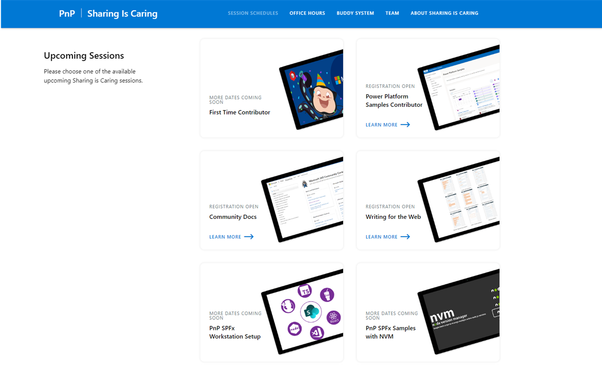
GUIDANCE
Learn how to get started in the open-source PnP community!
Upcoming Sessions:
First-time contributor
Power Platform Samples Contributor
Writing for the Web
Community docs
Using PnP SPFx samples w/ NVM
SPFx developer workstation setup
More than code with VS Code
First-time presenter
M365 Maturity Model Practitioners
https://aka.ms/sharing-is-caring
Notes:
25 Total attendees, 16 attendees who attended both First-Time Contributors and Community Docs sessions.

Slide 9





COMMUNITY
PnP Recognition Program
Showcase your contributions
Powered by Credly
More achievement levels coming soon
https://aka.ms/m365pnp-recognition
Notes:
25 Total attendees, 16 attendees who attended both First-Time Contributors and Community Docs sessions.

Slide 10
SharePoint Framework Latest from Microsoft engineering for Microsoft Viva, Microsoft Teams and SharePoint extensibility

Slide 11
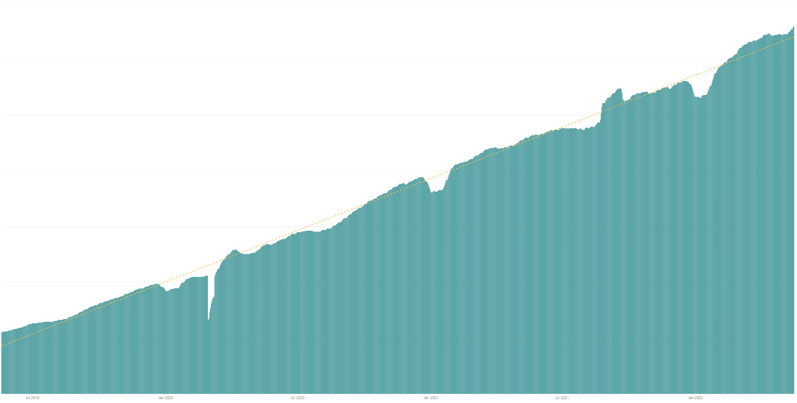

Rolling 28 days active users (MAU) for custom SharePoint Framework components in M365 There are currently tens of millions of monthly active users for customer and partner created SharePoint Framework components in Microsoft 365
Jul 2019
Jan 2020
Jul 2020
Jan 2021
Jul 2021
Jan 2022

Slide 12




The Road Ahead – 1.15 Release – ETA June 2022
Q2 CY 2022
Latest 1.15 preview release – New beta out soon
New Action types for media and geolocation – Tutorial just published
Support for Microsoft Graph SDK V3
Bug fixes and adjustments based on GitHub issues
New customizers for add and edit list / library forms
Available later as we progress in 1.15 development
Adaptive Card Extensions card view caching
Adaptive Card Extensions Error Handler Method
Adaptive Card Extensions card view caching – move to GA
Leverage Teams OBO flow for SPFx components in Teams Web
Support for TypeScript V4
Support for Teams SDK v11 (or newer – most likely 1.12.1)
Enable Service Principal Registration in app acquisition flow
Isolated Adaptive Card Extensions (Beta)
Post 1.15
Bots Powered Adaptive Card Extensions (Beta)**
Support for Node V16 – Delayed unfortunately due to dependency on Office UI Fabric/Fluent version used in SharePoint Online

Slide 13

PnPjs Client-Side Libraries

Slide 14
























PnPjs Client-Side Libraries
Version 3.3 released May 17th
General documentation updates
Add getLockedByUser method for files
Add chat message to Teams channels
Addresses many reported issues and enhancements
3.3.1 released May 17th – due to path issue
3.3.2 release May 18th – due to MacOS post-install script issue
Don’t forget about the nightly builds
npm install @pnp/sp@v3nightly --save
Docs: https://pnp.github.io/pnpjs/ @m365pnpjs on twitter

Slide 15
CLI for Microsoft 365

Slide 16
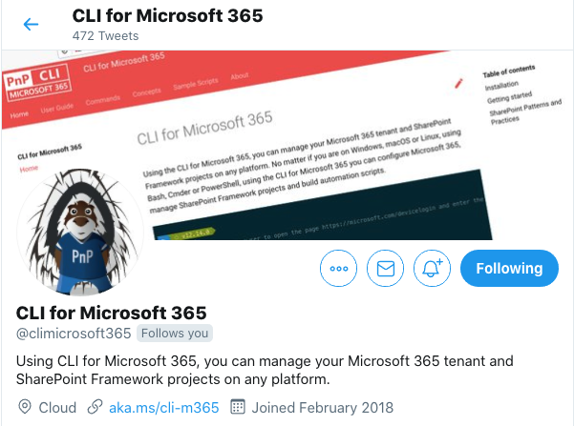
CLI for Microsoft 365
Adam Wójcik and Martin Lingstuyl are maintainers 👏 🎉
New beta version v5.3 with:
Managing list and list item permissions
Retrieving list of security alert for your tenant
Easily opening the management page for an Azure AD app in the Azure Portal
Extended support for Planner
Install v5.3 beta:
npm install -g @pnp/cli-microsoft365@next
docker run --rm –it m365pnp/cli-microsoft365:next
Release notes:
https://pnp.github.io/cli-microsoft365/about/release-notes/#v530
Available natively in Azure Cloud Shell
@climicrosoft365 #CLIMicrosoft365 on Twitter
📖 aka.ms/cli-m365
🗣 github.com/pnp/cli-microsoft365/discussions

Slide 17
SPFx Reusable Components

Slide 18
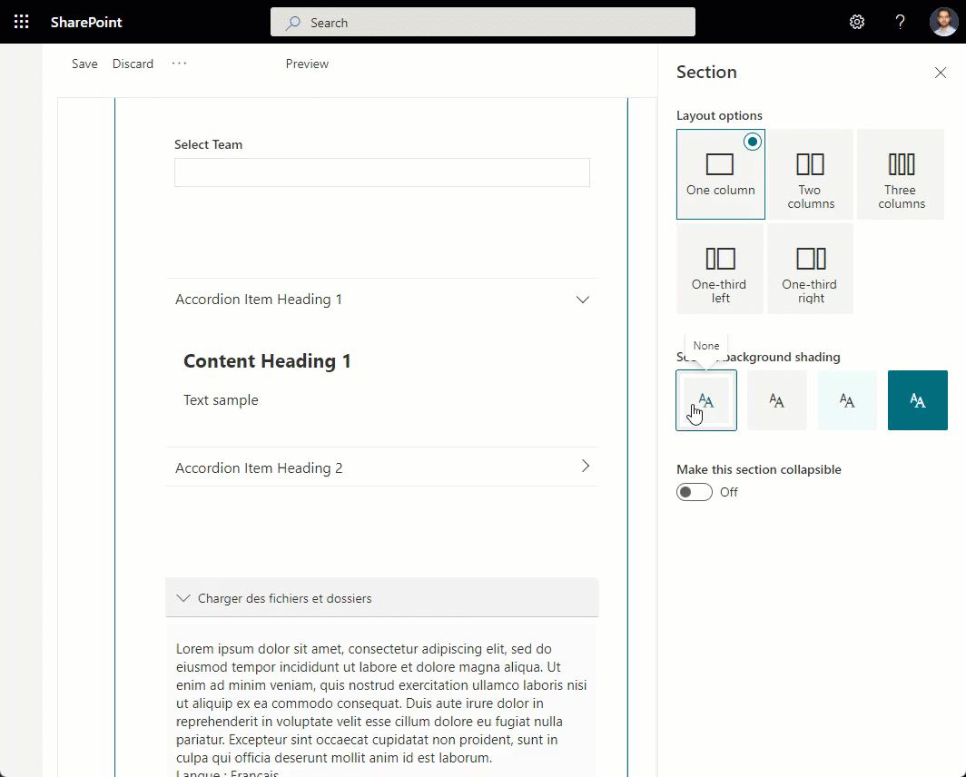
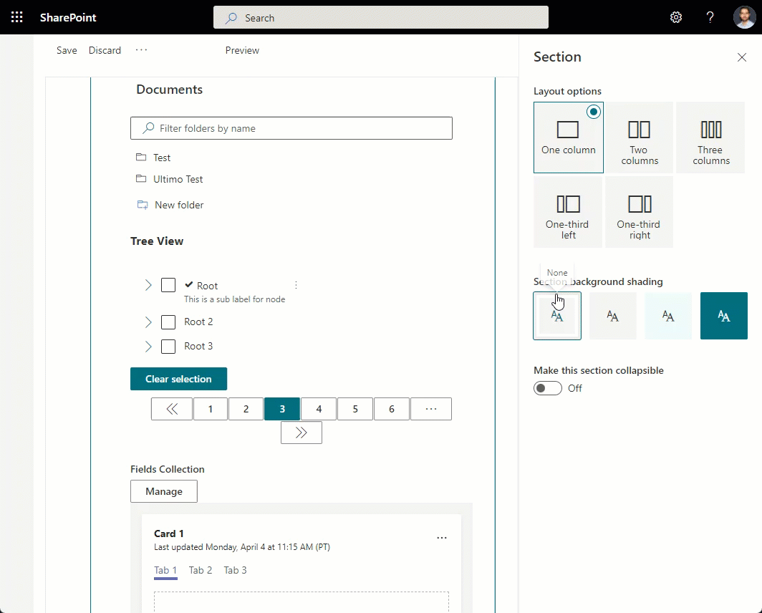
Reusable SPFx Controls
React Controls – 3.8.0
PeoplePicker enhancements: ability to provide multiple group id-s, search in nested groups
AdaptiveCardHost enhancements: add SPFx context, re-think CSS classes generation
Support for section backgrounds in AccessibleAccordion and TreeView
Various fixes
Release notes: https://pnp.github.io/sp-dev-fx-controls-react/about/release-notes/
React Property Controls – 3.7.0
PropertyFieldListPicker: ability to provide content type id
PropertyFieldColorPicker: provide preview of the selected color
Release notes: https://pnp.github.io/sp-dev-fx-property-controls/about/release-notes/
Special thanks to our contributors: Andreas Omayrat, brianpmccullough, Christophe Humbert, Fabio Franzini, Gautam Sheth, Joel Lopes, Milan Holemans, Patrik Hellgren, Ravichandran Krishnasamy, Rico van de Ven, Russell gove.
More information:
https://sharepoint.github.io/sp-dev-fx-property-controls https://sharepoint.github.io/sp-dev-fx-controls-react
Twitter: @M365PnPControls

Slide 19
PnP Modern Search

Slide 20
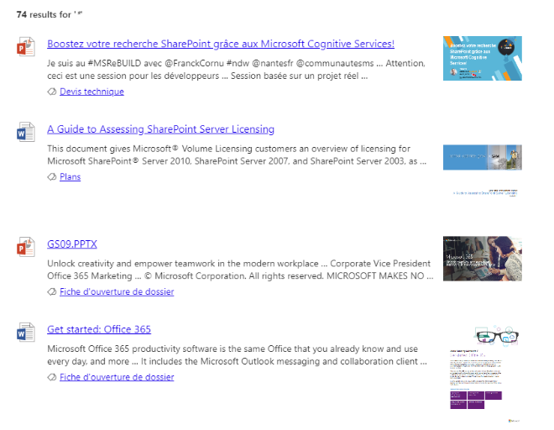

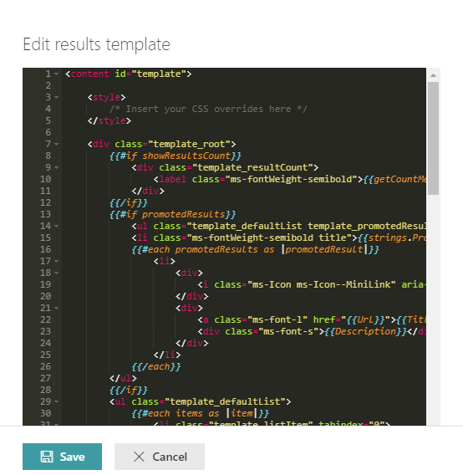
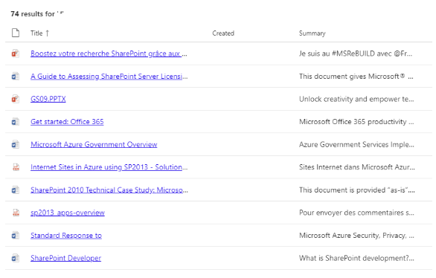

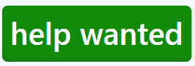
PnP Modern Search
http://aka.ms/pnp-search
Building modern Search experiences with flexible web parts
Adaptive Card support in the works :)
v4.6.1 – April 2022 release
https://github.com/microsoft-search/pnp-modern-search/releases/latest
Thank you @gszdev, @kachihro, @edarroudi, @eduardpaul, @dominiqueborer, @kflogdev for your support 😍
See release notes for fixes and new features
v3.23.0 – December 2021 release
https://github.com/microsoft-search/pnp-modern-search/releases
See release notes for fixes and new features
Notes:
https://github.com/microsoft-search/pnp-modern-search

Slide 21

PnP SPFx Samples

Slide 22
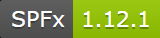
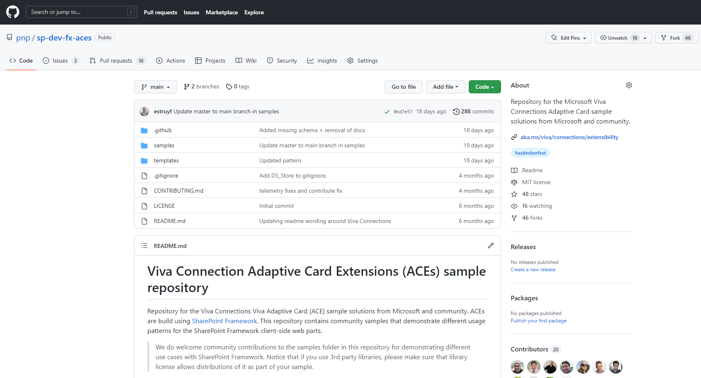
PnP SPFx ACEs
PnP SPFx Samples
PnP SPFx Samples
https://aka.ms/spfx-aces
No New Samples 😿
Open PR’s will be processed soon
*** We Love New Samples ***
Follow Documents André Lage | @aaclage
Notes:
This adaptive card extension sample demonstrate ability to monitor security risks using identity protection graph api from Viva Connection Dashboard
SPFx extensions https://aka.ms/spfx-extensions
Copy/Move Items within Lists Sudharsan Kesavanarayanan | @sudharsank This application customizer will display a command button named Copy/Move Item(s) in all the custom lists. Using this option, the items can be copied or moved from one list to another within the site.
https://github.com/pnp/sp-dev-fx-extensions/tree/main/samples/react-command-copy-move-items
SPFx web parts https://aka.ms/spfx-webparts
Applications Secrets Expiration Aimery Thomas | @a1mery This sample web part shows the list of your applications registered in Azure AD along with their associated client secret/certificate expiration date. https://github.com/pnp/sp-dev-fx-webparts/tree/main/samples/react-graph-app-secret-expiration
Teams Membership Updater
Nick Brown | @techienickb
Fixed the /members in the private channel membership URL
Advanced Page Properties Abderahman Moujahid | Abderahman88
Added support for web parts on sites in a different language
NEW: News Alison Collins | ReactIntern Web part pulls all SharePoint News Posts that the logged in user has access to view.
Pagination ( Back/Next ) and Page Display ( n out of n )
Select Multiple Sites ( Defaults to site webpart is deployed to )
Two styling options, Stack or Single
News Title as link ( Click to go to post )
News Thumbnail Image
Preview of Description
Author ( Can toggle visibility in Property Pane )
Created Date
Likes with Office UI Fabric Icons
Comments with Office UI Fabric Icons ( Also retrieves nested comments )
https://github.com/pnp/sp-dev-fx-webparts/tree/main/samples/react-news

Slide 23
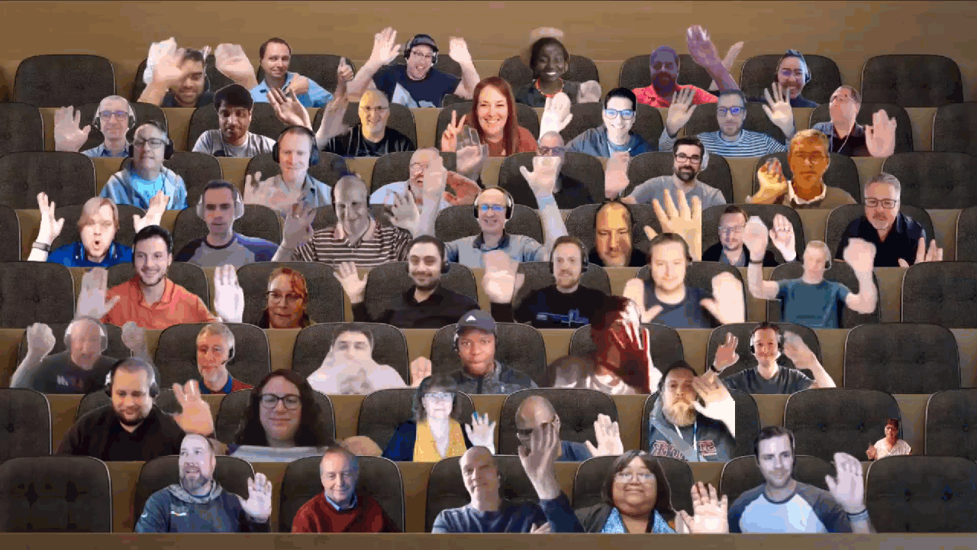

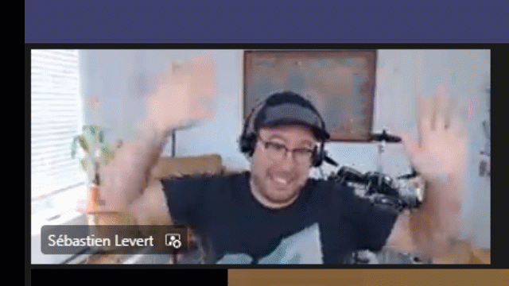
Optional picture time!
Video on and we’ll grab a Together Mode pic with those who are willing to do this.
We are together on this as a community!
Let’s all be like Seb?
By enabling your camera for the picture, you grant us permission to share your picture in social media.

Slide 24

DEMO
Building Office Locations Viva Connections Adaptive Card Extension with SPFx
– Anoop Tatti
Using Adaptive Cards Designer control from the PnP control gallery in SPFx solutions – Fabio Franzini

Slide 25
Thank you
Recording will be available in 24 hours on
Microsoft 365 Community (PnP) YouTube channel
https://aka.ms/M365/videos
(subscribe today)
Follow us on Twitter
@Microsoft365Dev | @M365PnP
Next Viva Connections & SPFx call: June 2nd at 07:00am PT
Next M365 General Dev call: May 26th at 07:00am PT
All available community calls from https://aka.ms/m365/calls

Slide 26


aka.ms/m365pnp

